Slide 1
CS 295A/395D: Artificial Intelligence
Partial Observability and Markov Decision Processes (MDPs)
Prof. Emma Tosch
25 April 2022

Slide 2
Logistics
Worksheet due Wednesday, programming assignment soft deadline Friday
Discussion about final topics in the class & final in-class exam
Do this at the end of class
Final exam plan
Especially encourage graduate students (model/dry run for qualifying exam)
Will cover entire course
40 Multiple choice
2 design questions (pick one)
2 computational questions (pick one)

Slide 3
Agenda
Handout question 18
Review: Markov Chains
Partially observed MDPs (Hidden Markov Models – HMMs)
Markov Decision Processes (MDPs)
Introduce Reinforcement Learning

Slide 4
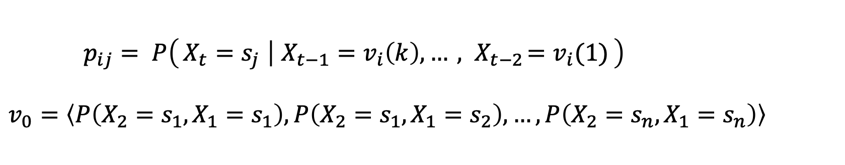
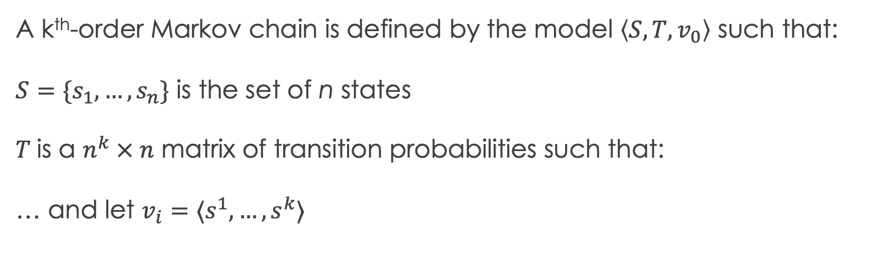
Recall: k^{th}-order Markov Chain
A k^{th}-order Markov chain is defined by the model $\left\langle S, T, v_{0}\right\rangle$ such that:
$S=\{s_{1},…, s_{n}\}$ is the set of n states
$T$is a $n^{k} × n$ matrix of transition probabilities such that:
… and let $v_{i}=⟨s^{1}, …, s^{k}⟩$
$p_{ij}= P\left(X_{t}=s_{j} ∣ X_{t−1}=v_{i}\left(k\right), …{ , X}_{t−2}=v_{i}(1)\right)$
$v_{0}=\left\langle P\left({X_{2}=s_{1}, X}_{1}=s_{1}\right), P\left({X_{2}=s_{1}, X}_{1}=s_{2}\right), …, P\left(X_{2}=s_{n}, X_{1}=s_{n}\right)\right\rangle$

Slide 5
Recall: Important MC properties
Irreducibility (reachability)
For all pairs of states (s, s’) , there exists a sequence of states from s to s’ such that the transition probability from s to s’ is not zero.
Aperiodicity (coverage)
Beyond an index k, it must be possible to observe all states in all indices starting with k+1.

Slide 6
Recall: MCMC
These properties ensure there is a unique stable distribution.
The existence of a unique stable distribution makes Markov Chain Monte Carlo (MCMC) sampling possible.
MCMC is a family of sampling algorithms. Most famous:
Gibbs Sampling
Hamiltonian MCMC

Slide 7
Unobserved or Partially Observed Markov Chains
Thus far: assumed we knew what state we were in (“observed”)
Sometimes we don’t know!
Example: Part of speech tagging
Parts of speech (e.g., noun, verb, adjective) are necessary for parsing
Parsing is the classical backbone of text analysis

Slide 8
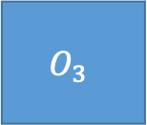
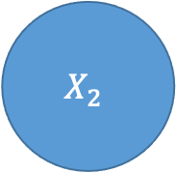
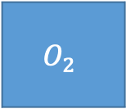
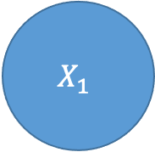
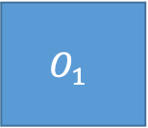
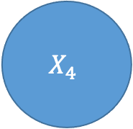
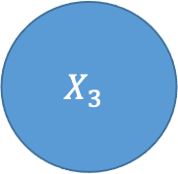
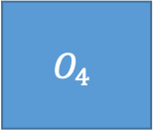
Example POS tagging
$$X_{1}$$
$$X_{2}$$
$$X_{3}$$
$$X_{4}$$
$$O_{1}$$
$$O_{2}$$
$$O_{3}$$
$$O_{4}$$

Slide 9
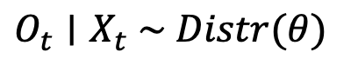
Example POS tagging
$$O_{t}∣X_{t} \sim Distr(θ)$$
$$X_{1}$$
$$X_{2}$$
$$X_{3}$$
$$X_{4}$$
$$O_{1}$$
$$O_{2}$$
$$O_{3}$$
$$O_{4}$$
Need to augment model $⟨S, T, v_{0}⟩$ with emission probabilities for the observations

Slide 10
Example POS tagging
$$X_{1}$$
$$X_{2}$$
$$X_{3}$$
$$X_{4}$$
The
quick
brown
fox

Slide 11
Example POS tagging
DT
JJ
NN
NN
The
quick
brown
fox

Slide 12
Example POS tagging
DT
JJ
NN
NN
The
quick
brown
fox

Slide 13
Planning vs. Inference vs. Learning
So far we have focused on planning:
We know the structure of the problem space
We need to navigate the problem space, e.g.
Searching for proof trees
Robot navigating a room
Making optimal choices under uncertainty
Primary challenge has been to navigate a very large space of options

Slide 14
Planning vs. Inference vs. Learning
We have recently encountered inference:
Given a model that may contain uncertainty, draw conclusions from that model
Planning uses inference to selection actions
Inference relies on us having a good enough model of the problem
Learning is the study of procedures for crafting that model from data

Slide 15
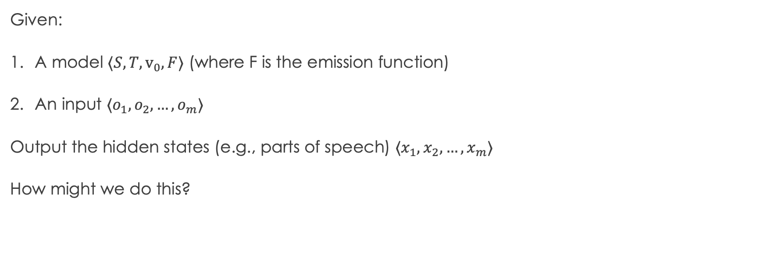
Inference problem for HMMs
Given:
A model $⟨S, T, v_{0}, F⟩$ (where F is the emission function)
An input $⟨o_{1},o_{2},…, o_{m}⟩$
Output the hidden states (e.g., parts of speech) $⟨x_{1},x_{2},…, x_{m}⟩$
How might we do this?

Slide 16
Exercise: suboptimality of greedy inference

Slide 17
Solution: forward-backward reasoning
Idea:
Use dynamic programming (i.e., memorization) to find most likely state
Computes forward and backward passes
Uses Bayes rule and law of total probability to get the marginal likelihood over a single state
Naïve approach highly localized – does not consider sequence
Max sequential path: Viterbi algorithm

Slide 18
Machine Learning vs. AI for text
POS tagging less popular proportionally
Requires expensive data sets to train
Mature field (fewer opportunities to publish in top conferences)
Requires domain knowledge for new languages (linguistics)
Off-the-shelf pre-trained software works, can build into pipelines
Now: deep neural networks for text analysis
Can skip intermediate steps (don’t need the POS in the first place)
Thus, can often skip domain-specific knowledge of language structure
Uninterpretable, hard to debug
Power usage to train

Slide 19
MDPs, formally

Slide 20
Reward vs. utility?
There are effectively all the same; why use different terms?
Early in the semester:
Cost
Later:
Utility
Now:
Reward
ML, from statistics
Utility theory (economics)
Reinforcement (psychology)

Slide 21
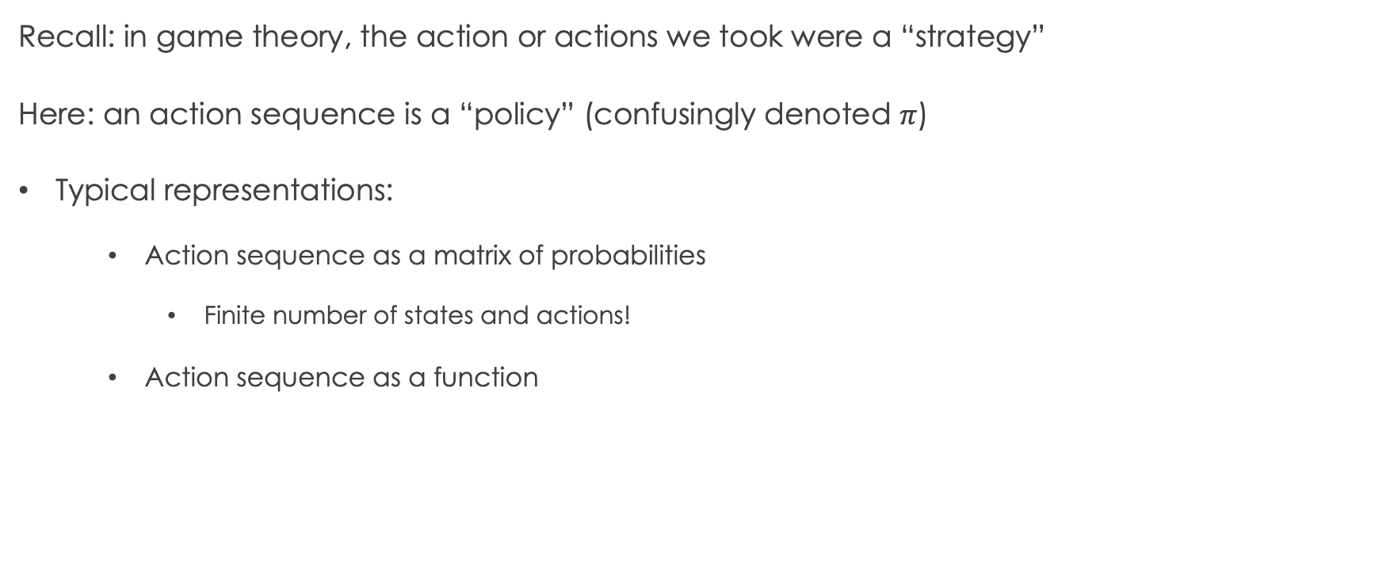
Action selection representation
Recall: in game theory, the action or actions we took were a “strategy”
Here: an action sequence is a “policy” (confusingly denoted $π$)
Typical representations:
Action sequence as a matrix of probabilities
Finite number of states and actions!
Action sequence as a function

Slide 22
Similarities with decision theory
Finite state space (at least in our course)
Finite action space (again, in our course)
Objective: maximize utility (minimize cost, maximize reward)
Elides aleatory and epistemic uncertainty

Slide 23
Differences compared with decision theory
Decision trees
Finite horizon (tree has finite size)
Small branching factor
State nodes not necessarily ordered
Decisions/actions decoupled from state
Purely associational
MDPs
Infinite horizon (potentially infinite chain)
Potentially very large branching factor
State nodes must be ordered
Decisions/actions tightly coupled with state
Sometimes causal (maybe not identifiable)

Slide 24
Do actions mutate state?

Slide 25
MDPs vs. Reinforcement Learning (RL)
Who here has heard of reinforcement learning?
MDPs are about the problem space
RL is about learning an optimal policy (i.e. strategy) for acting in a dynamic environment
RL can be used to learn over MDPs, but these two concepts are not synonymous!
If the environment can be modeled as an MDP, certain things become easier
Classical RL assumed MDPs
Modern RL does not

